Slide 1
Bearcat Events
By Akhil Mallepally and Kushal Katari

Slide 2
Link to the application on the web :
https://bearcat-events.herokuapp.com/

Slide 3
Why this app?
The app would let the users to add, update and Delete Events. There are various student organizations in Northwest. Each student organization conducts various events during every semester. Our application integrates the events from this organizations into one platform where users can know about them.

Slide 4
Who will use it?
As Students of Northwest Missouri State University are back to in-person classes, we would like to create an application that reminds students about the events happening in the University. The events can be from any Organization in the university like SAC, ISO, ACM, ISA etc. The main purpose of this application is to encourage students to participate in all events.

Slide 5
What is the main purpose?
The main purpose of this app is to create an Event Reminder Progressive Web Application that can be viewed on any device.

Slide 6
Tech Stack
Frontend - Next.js
Hosting platform - Heroku
Data Host - Heroku PostgreSQL
Responsive design - BootStrap
Backend - Django

Slide 7
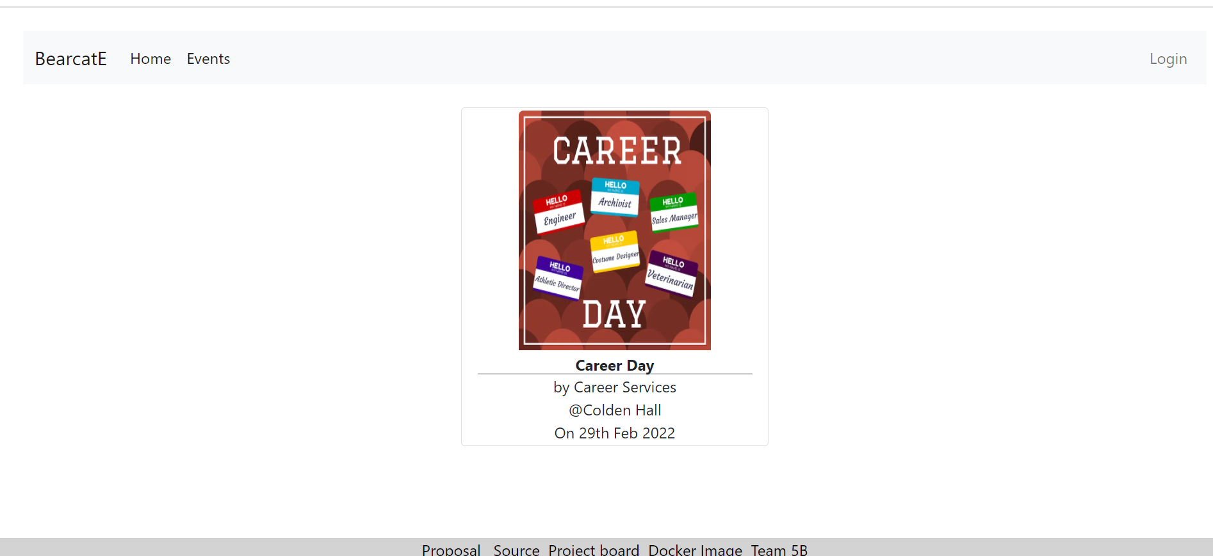
Home Page

Slide 8
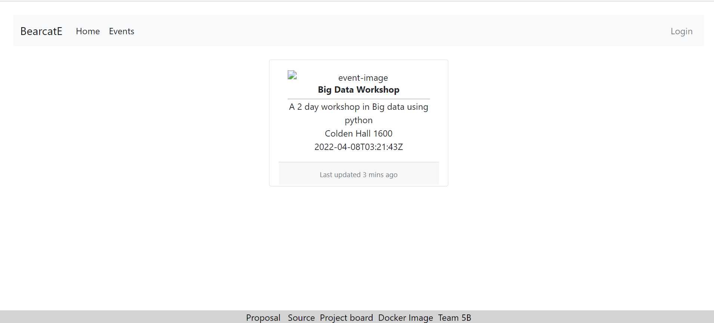
Event page

Slide 9
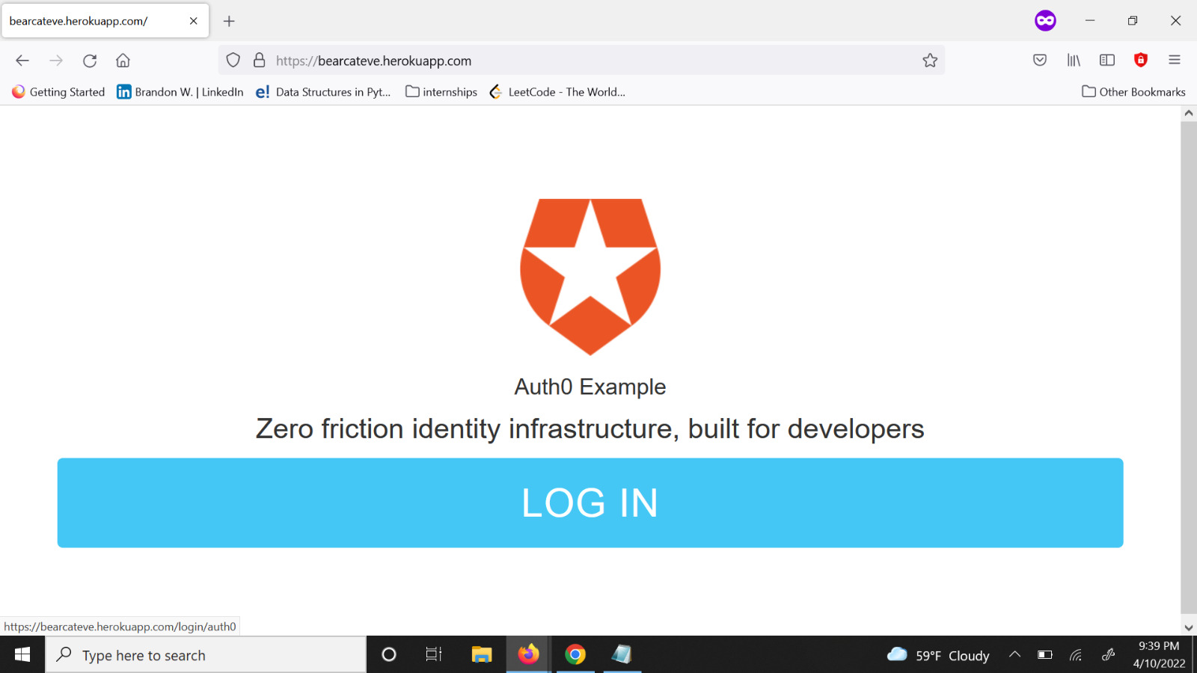
Auth0 Login

Slide 10
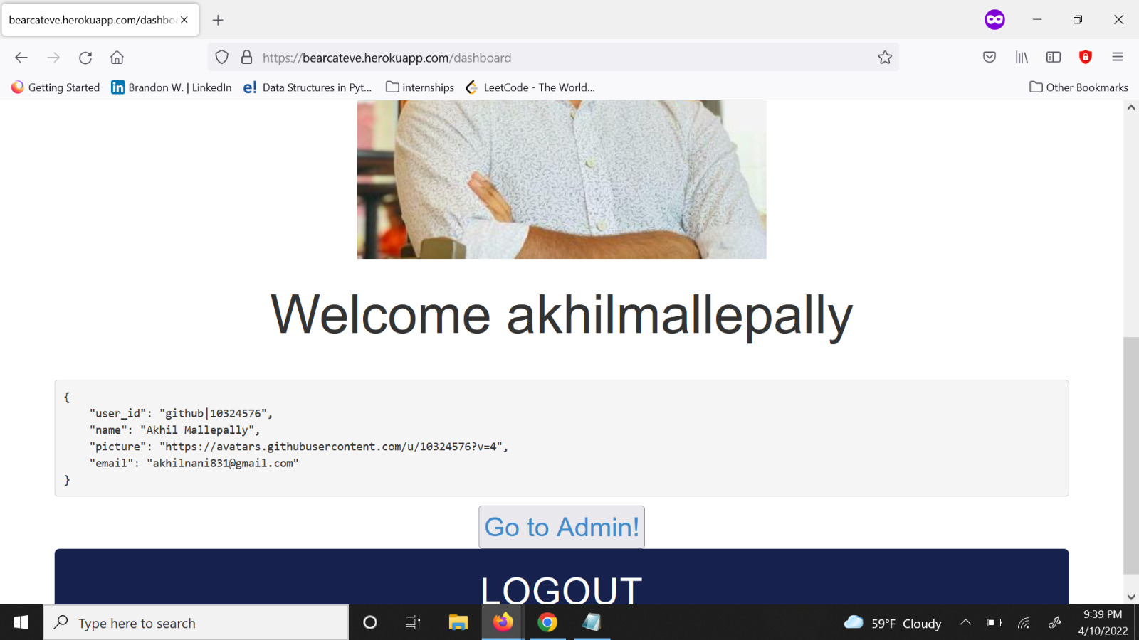
Welcome page

Slide 11
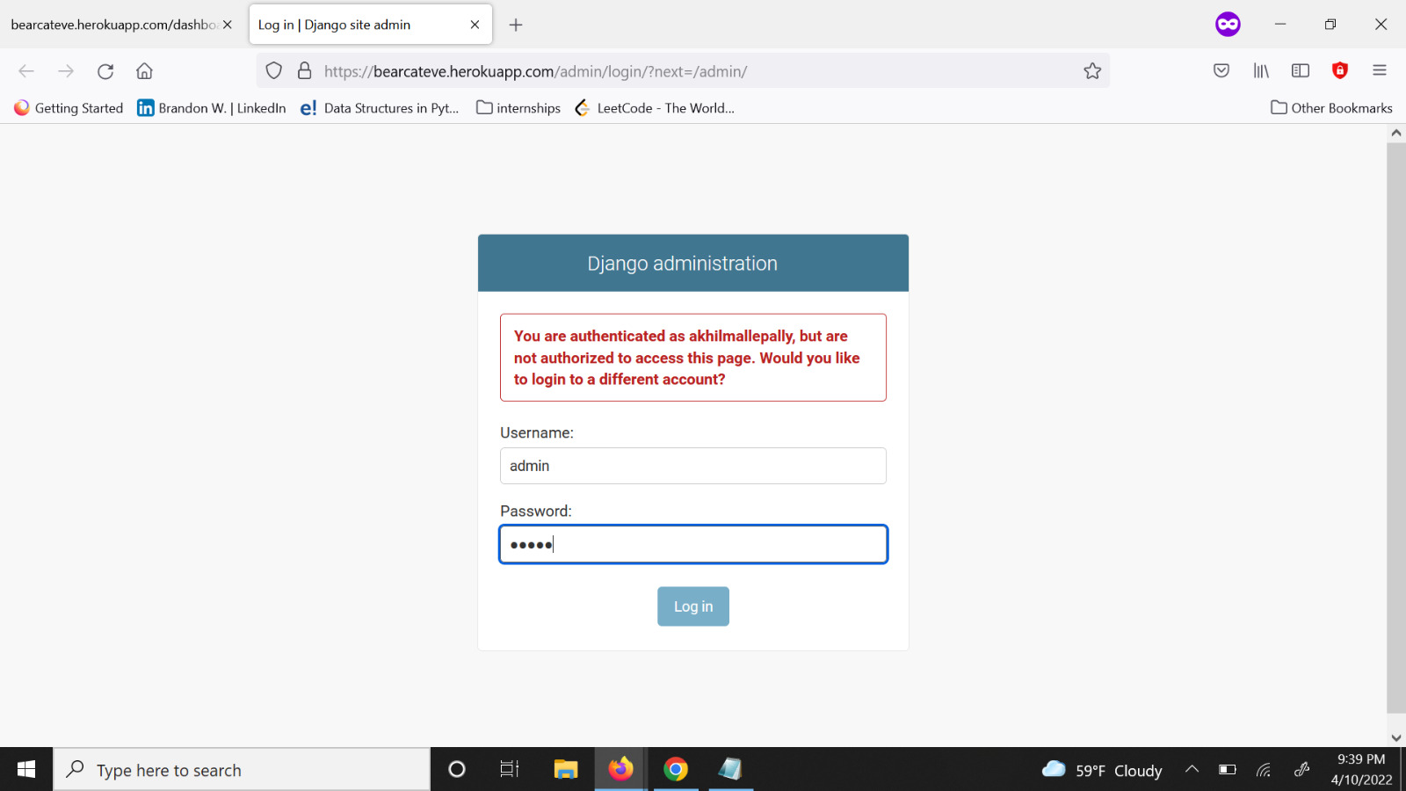
DJANGO ADMINSTRATION PAGE

Slide 12
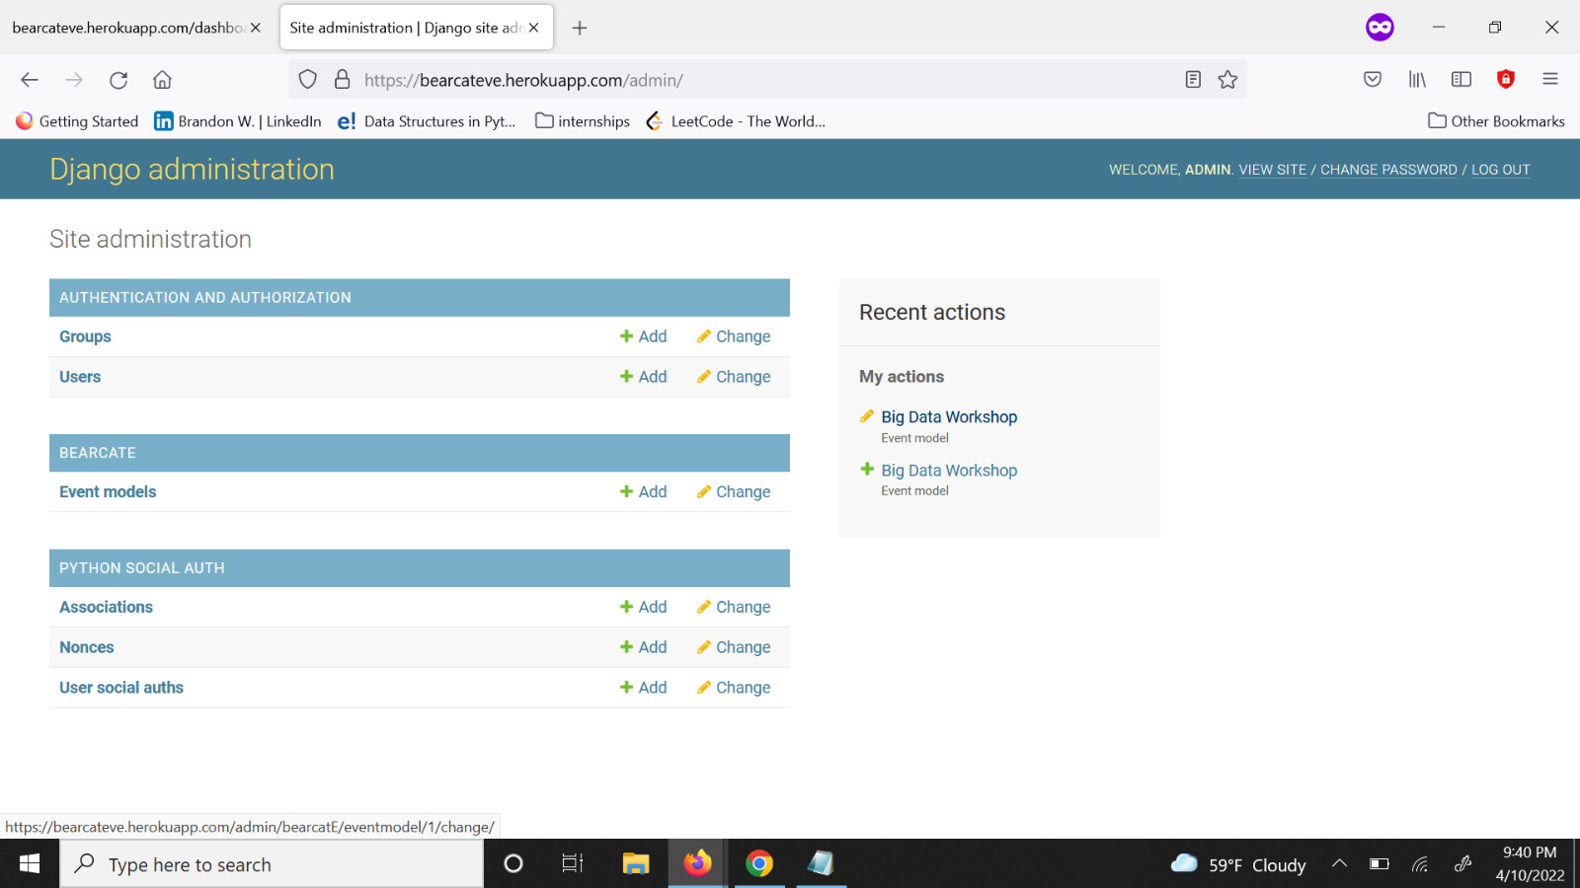
OVERVIEW

Slide 13
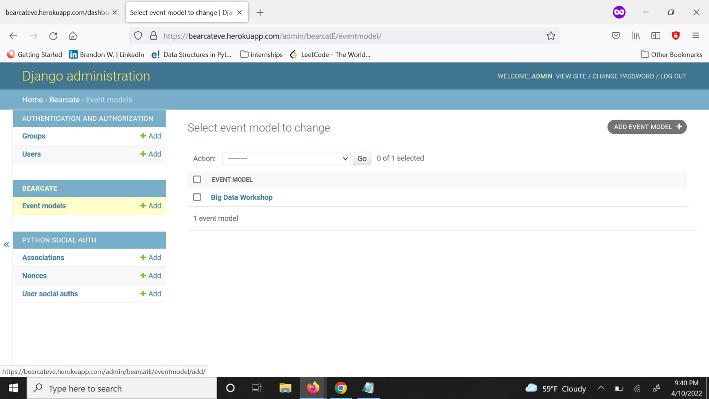
EVENT MODELS

Slide 14
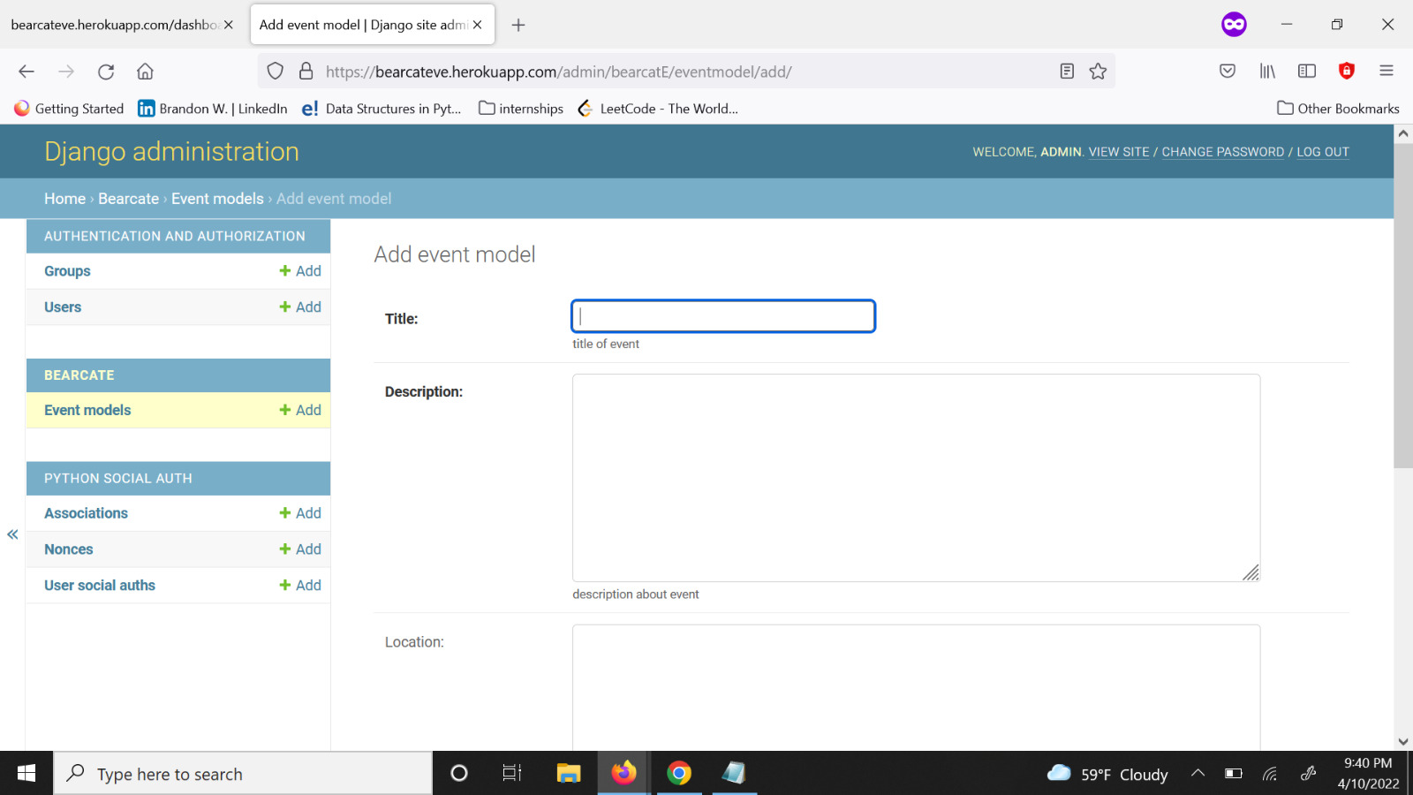
ADD EVENT

Slide 15
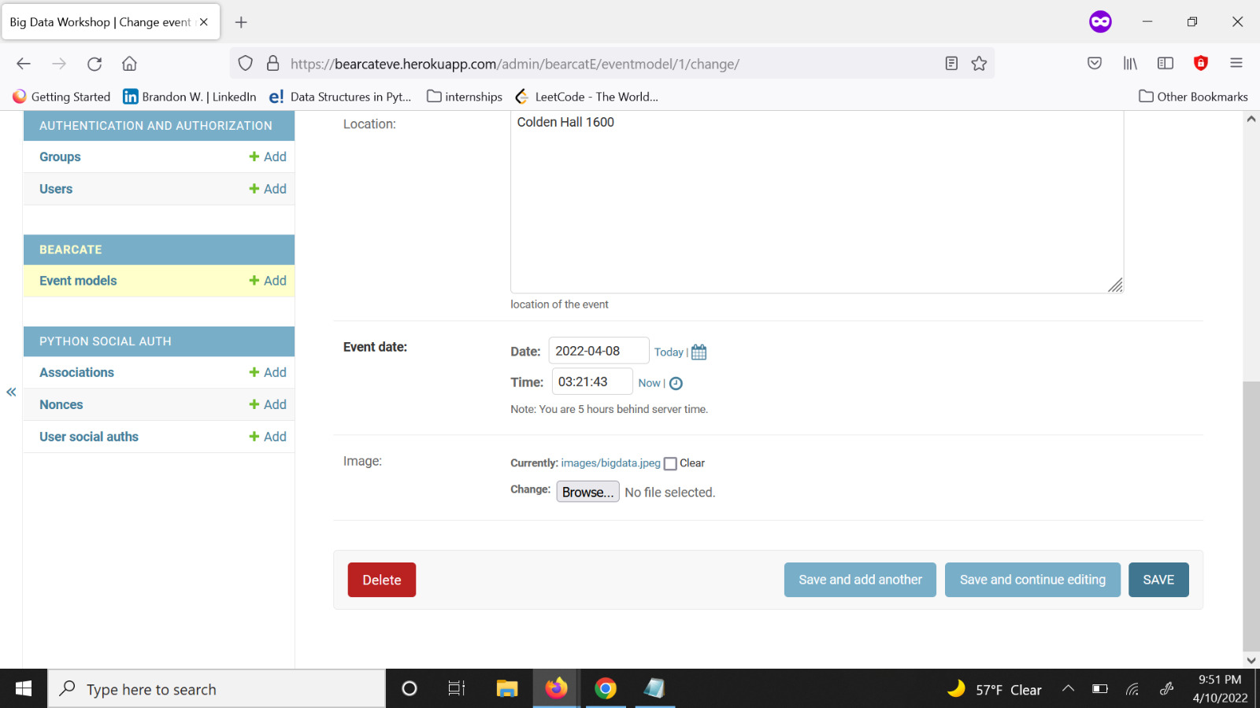
DELETE EVENT

Slide 16
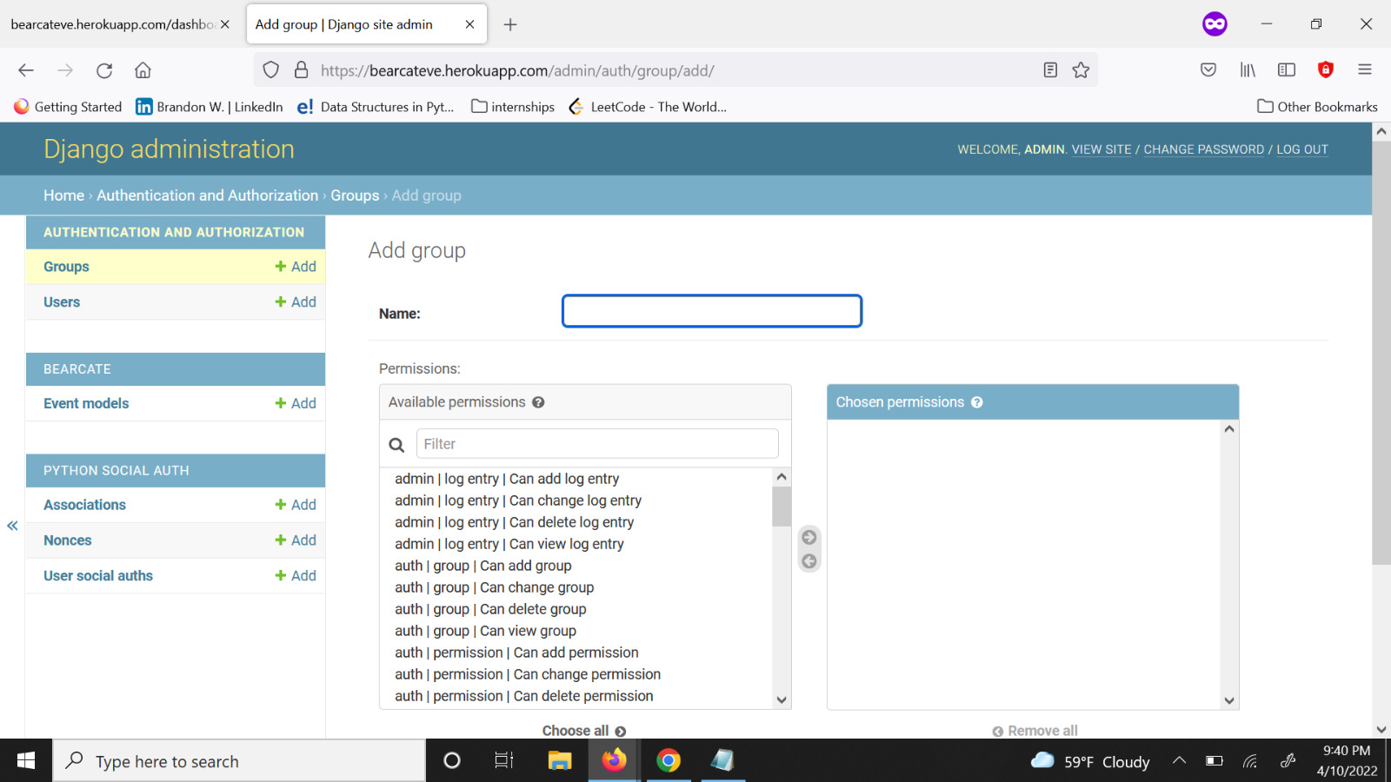
GROUP AUTHENTICATION

Slide 17
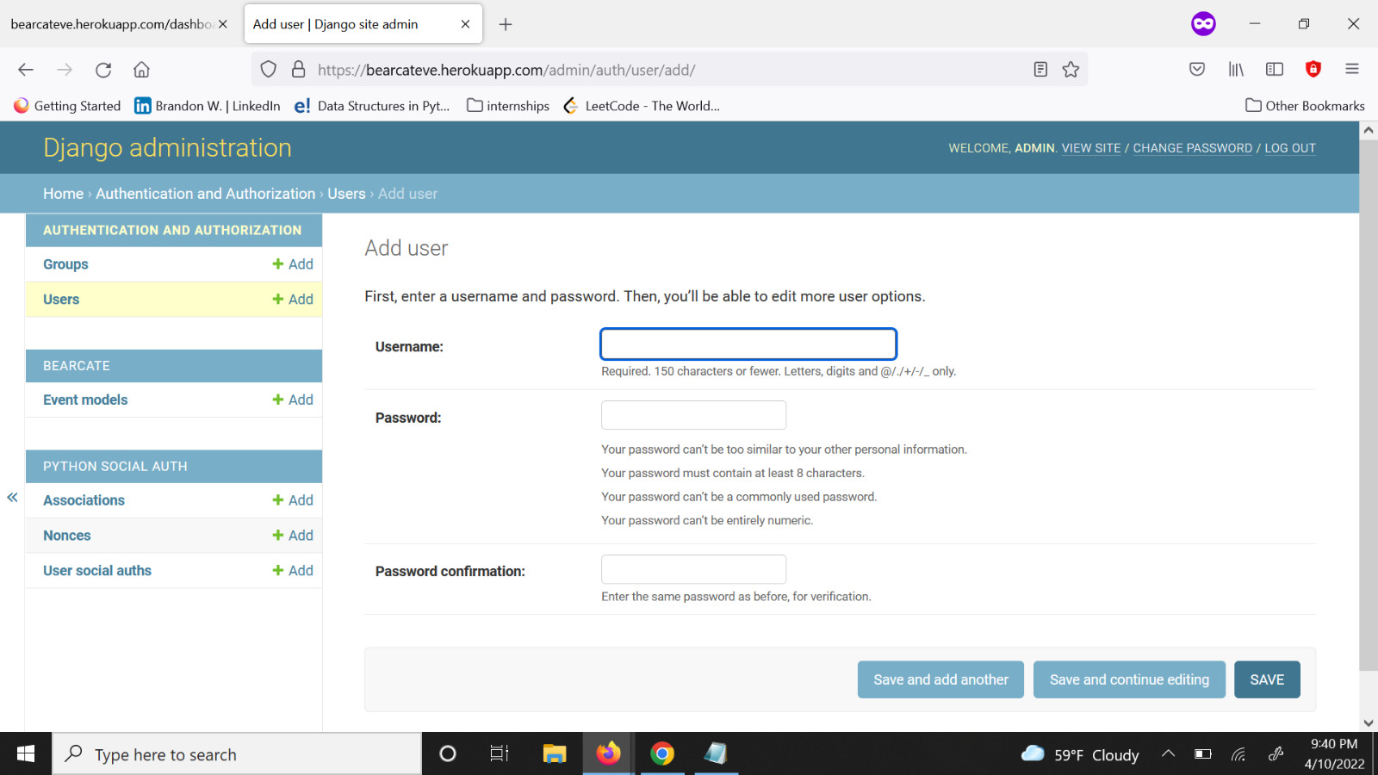
INDIVIDUAL AUTHENTICATION

Slide 18
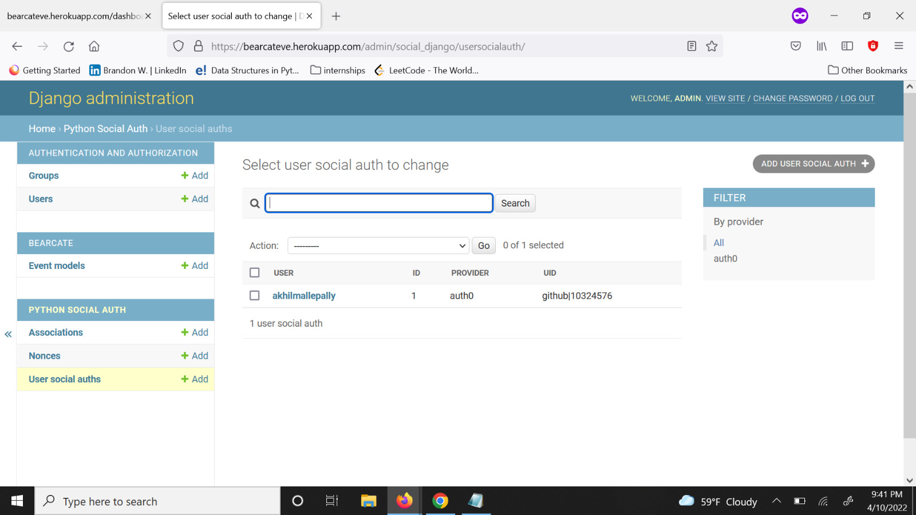
SOCIAL AUTHENTICATION

Slide 19
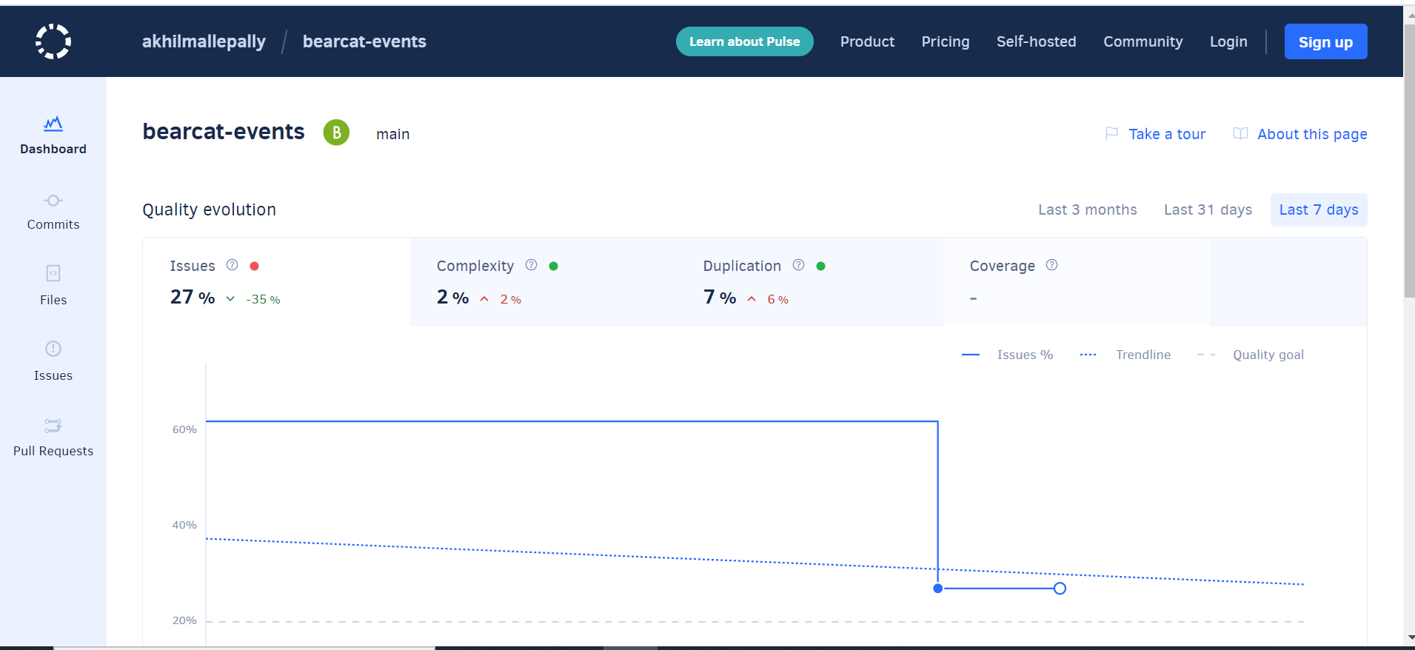
Codacy

Slide 20
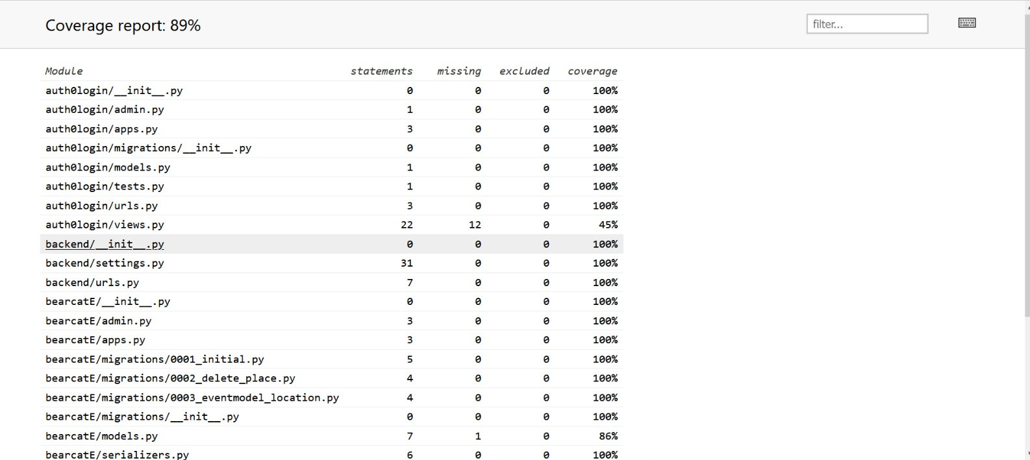
Test coverage

Slide 21
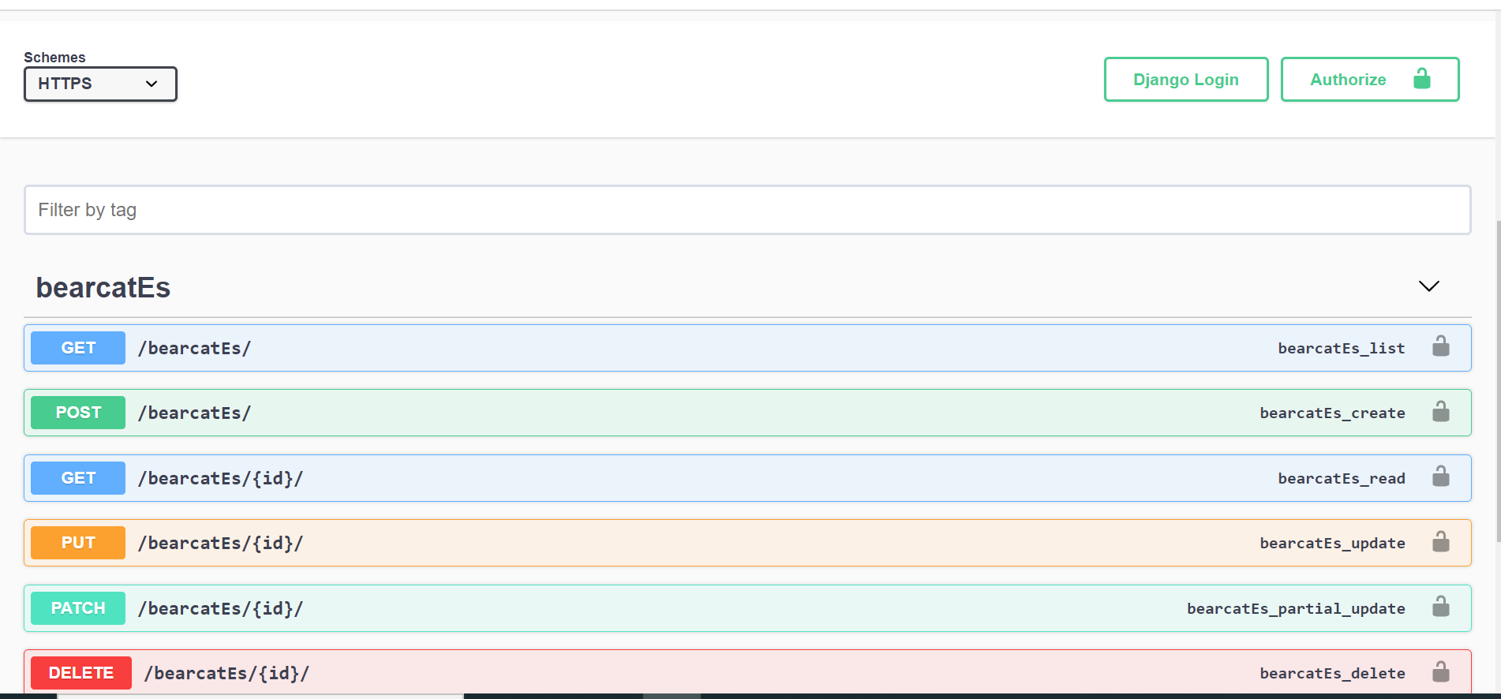
swagger

Slide 22
Lessons learned
Django and Next.Js is something we've got to learn about.
We learned about Swagger, Unit Testing, Codacy Etc.. We didn’t even know about this before.
We’ve got some experience with GitHub.
Mainly learnt how to operate in a group and manage the time.
The auth0 authentication is really worthy and Knowledgeable.

Slide 23
links
Repo
Swagger
Codacy
Wiki
Project Board
Proposal
Hosted Site

Slide 24

Thank you

